Slide 1

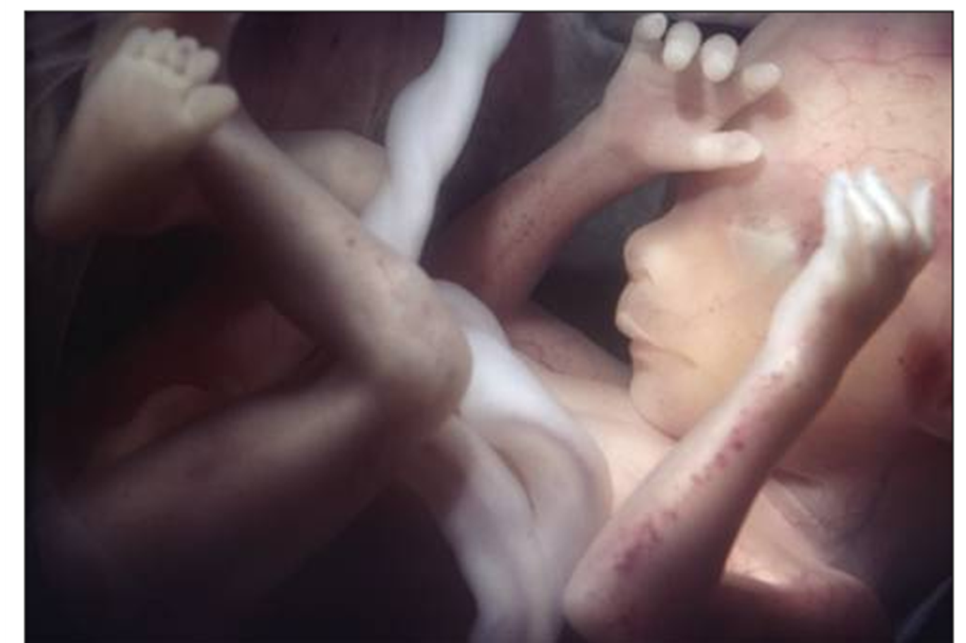
Arsi University
College of Health science
Department of pediatrics and child health
PROBLEMS OF PREMATURITY
By Tejitu U. (Pediatrician)

Slide 2
OUTLINE
Introduction
Causes/risk factors of preterms and LBW
Problems associated with preterms and LBW
General management of premature babies

Slide 3
Newborn classification
Based on GA
A. Preterm:
    Infants born before 37 wk of GA.
B. Term:
    Infants born b/n 37 &42 wks of GA.
C. Postterm:
    Infants born after 42 wks of GA.

Slide 4
Conti…
2. Based on birth weight (BW)
A. Normal BW (NBW):-2500 gm – 4000 gm
B. Low BW (LBW):-1500 – 2500 gm
C. Very LBW(VLBW):-1000 – 1500 gm
D. Extremely LBW(ELBW):- <1000 gm
E. Macrosomic:- > 4000 gm

Slide 5
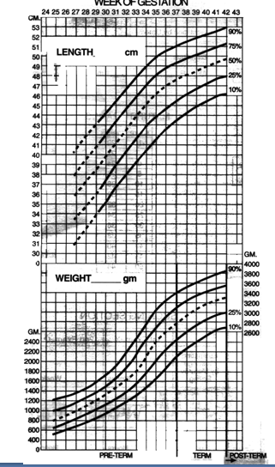
Conti…
3. Based on BW in relation to GA
A. AGA:- b/n 10-90th percentile
B. SGA:- less than 10th centile
C. LGA:- greater than 90th centile

Slide 6
Prematurity and LBW
Definition:
Preterms:- Live born infants delivered before 37 wk from the 1st day of the last menstrual period.
LBW:-is birth weight less than 2500 gram
LBW is due to prematurity OR poor intrauterine growth (IUGR / SGA), or both.
Prematurity and IUGR are associated with increased neonatal morbidity and mortality.

Slide 7
IDENTIFIABLE CAUSES OF PRETERM BIRTH
FETAL
  Fetal distress
  Multiple gestation
  Erythroblastosis
  Nonimmune hydrops
PLACENTAL
  Placental dysfunction
  Placenta previa
  Abruptio placenta

Slide 8
Conti…
UTERINE
  Bicornuate uterus
  Incompetent cervix (premature dilatation)
MATERNAL
  Preeclampsia
  Chronic medical illness (cyanotic heart disease, renal disease)
  Infection (Listeria mono, GBS, UTI, bacterial vaginosis, chorioamnionitis)
  Drug abuse (cocaine)

Slide 9
Conti…
OTHERS
  Premature rupture of membranes
  Polyhydramnios
  Iatrogenic
  Trauma

Slide 10
NEONATAL PROBLEMS ASSOCIATED WITH PREMATURE INFANTS
METABOLIC-ENDOCRINE
    Hypoglycemia
    Hypothermia
    Hypocalcemia
    Hyperglycemia
    Late metabolic acidosis
    Euthyroid but low-thyroxin status
INFECTIONS
    Due to reduced immunity

Slide 11
Conti…
RESPIRATORY
  Respiratory distress syndrome (hyaline membrane disease)
  Apnea
  Bronchopulmonary dysplasia
  Pneumothorax,
  pneumomediastinum
  interstitial emphysema
  Congenital pneumonia
  Pulmonary hypoplasia
  Pulmonary hemorrhage

Slide 12
Conti…
CARDIOVASCULAR
    Patent ductus arteriosus
    Hypotension
    Hypertension
    Bradycardia (with apnea)
    Congenital malformations

Slide 13
Conti…
HEMATOLOGIC
    Hyperbilirubinemia-indirect
    Subcutaneous, organ (liver, adrenal) hemorrhage
    Disseminated intravascular coagulopathy
    Vitamin K deficiency
    Anemia of prematurity (early or late onset)

Slide 14
Conti…
GASTROINTESTINAL
    Neonatal Necrotizing enterocolitis
    Poor gastrointestinal function-poor motility
    Hyperbilirubinemia-direct and indirect
    Congenital anomalies producing polyhydramnios
    Spontaneous gastrointestinal isolated perforation

Slide 15
Conti…
RENAL
    Hyponatremia
    Hypernatremia
    Hyperkalemia
    Renal tubular acidosis
    Renal glycosuria
    Edema

Slide 16
Acute Complication of prematurity
  Respiratory distress syndrome (HMD)
  Hypoglycemia
  Necrotizing enterocolitis
  Apnea of prematurity
  Hypothermia
  Sepsis
  Intraventricular hemorrhage
  Jaundice

Slide 17
late onset complications of prematurity
  Anemia of prematurity
  Retinopathy of prematurity
  Osteopenia of prematurity
  Bronchopulmonary dysplasia
  Developmental delay
  Mental retardation
  Hearing and vision deficit
  Patent ductus arteriosus

Slide 18
1. Respiratory Distress Syndrome
Respiratory distress syndrome (RDS), formerly known as hyaline membrane
disease (HMD),
Describes a disease typical of preterm infants that is caused by insufficient pulmonary surfactant in alveoli.

Slide 19
Etiology
Surfactant deficiency
    Decreased production and secretion- is the primary cause of RDS.

Slide 20
Incidence
Respiratory distress syndrome (RDS) occurs primarily in premature infants.
Its incidence is inversely related to gestational age and birth weight.
It occurs in:-
    60- 80% of infants <28 wk GA
    15–30% of those between 32 and 36 wk GA and
    Rarely in those >37 wk GA.

Slide 21
Risk factors
The risk for development of RDS increases with:
  Fetal sex
    Male infants are at higher risk for RDS
    - Due to the presence of circulating weak fetal androgens
    - Inhibit the production of surfactant phospholipids.
  Maternal diabetes
    Due to enhanced production of fetal insulin
    - Inhibits the production of proteins important for surfactant function.

Slide 22
Conti…
  C. Multiple births
  D. Cesarean delivery
  E. Precipitous delivery
  F. Asphyxia
  G. Cold stress
  H. Maternal history of previously affected infants
  I. Mutations in surfactant-related proteins

Slide 23
Conti…
The risk of RDS is reduced in:-
  Pregnancies with chronic or pregnancy-associated hypertension
  Maternal heroin use
  Prolonged rupture of membranes
  Antenatal corticosteroid prophylaxis.

Slide 24
Pathophysiology
As a consequence of progressive injury to epithelial and endothelial cells from atelectasis (atelectrauma), volutrauma, ischemic injury, and oxygen toxicity, effusion of proteinaceous material and cellular debris into the alveola spaces (forming the classic hyaline membranes) further impairs oxygenation.
Alveolar atelectasis, hyaline membrane formation, and interstitial edema make the lungs less compliant in RDS, so greater pressure is required to expand the alveoli and small airways.
Although surfactant is present in high concentrations in fetal lung homogenates by 20 wk of gestation, it does not reach the surface of the lungs until later.
  It appears in amniotic fluid between 28 and 32 wk.
  Mature levels of pulmonary surfactant are present usually after 35 wks. of gestation.

Slide 25
Conti…
Atelectasis results in perfused but not ventilated alveoli, causing hypoxia.
Decreased lung compliance, small tidal volumes, increased physiologic dead space, and insufficient alveolar ventilation eventually result in hypercapnia.
The combination of hypercapnia, hypoxia, and acidosis produces pulmonary arterial vasoconstriction with increased right-to-left shunting through the foramen ovale and ductus arteriosus and within the lung itself.

Slide 26
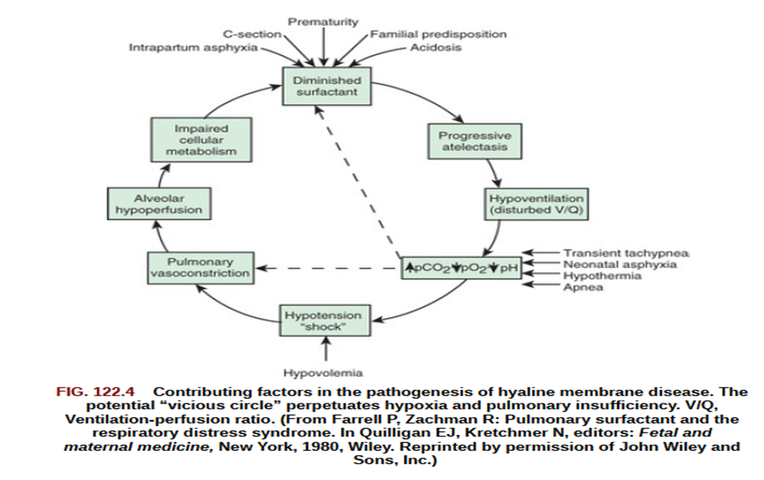
Conti…

Slide 27
Conti..
The major constituents of surfactant are dipalmitoyl phosphatidylcholine (lecithin), phosphatidylglycerol, apoproteins (surfactant proteins SP-A, SP-B, SP-C, and SP-D), and cholesterol.
  Surfactant recovered from lungs of all mammalian species by alveolar wash procedures contains 70% to 80% phospholipids, about 8% to 10% protein, and about 10% neutral lipids, primarily cholesterol.
  The phosphatidylcholine species of the phospholipids represents about 60% by weight of the surfactant and about 80% of the phospholipids.
  It is synthesized, packaged, and secreted from alveolar type II cells of the lung.

Slide 28
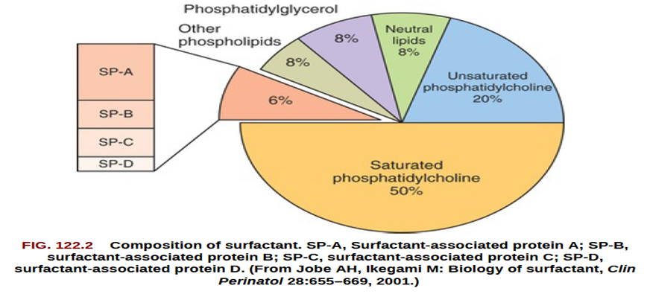
Conti…

Slide 29
Clinical Manifestations
Signs of RDS usually appear within minutes of birth, although they may not be recognized for several hours in larger premature infants, until rapid, shallow respirations become more obvious.
A later onset of tachypnea should suggest other conditions.
Some patients require resuscitation at birth because of intrapartum asphyxia or initial severe respiratory distress (especially with birthweight <1,000 g).

Slide 30
Conti…
Characteristically, tachypnea, prominent (often audible) expiratory grunting, intercostal and subcostal retractions, nasal flaring, and cyanosis are noted.
Breath sounds may be normal or diminished with a harsh tubular quality, and on deep inspiration, fine crackles may be heard.
The natural course of untreated RDS is characterized by progressive worsening of cyanosis and dyspnea.

Slide 31
Conti…
If the condition is inadequately treated, blood pressure may fall; cyanosis and pallor increase, and grunting decreases or disappears, as the condition worsens.
Apnea and irregular respirations are ominous signs requiring immediate intervention.
Untreated patients may also have a mixed respiratory-metabolic acidosis, edema, ileus, and oliguria.
Respiratory failure may occur in infants with rapid progression of the disease.

Slide 32
Conti…
In most cases the signs reach a peak within 3 days, after which improvement is gradual.
Improvement is often heralded by spontaneous diuresis and improved blood gas values at lower inspired O2 levels and/or lower ventilator support.
Death can result from severe impairment of gas exchange, alveolar air leaks (pulmonary interstitial emphysema, pneumothorax), pulmonary hemorrhage, or intraventricular hemorrhage (IVH).

Slide 33
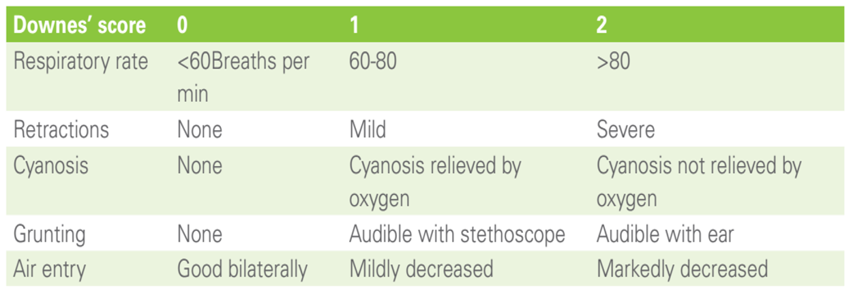
Downe’s score for grading severity of respiratory distress

Slide 34
Natural course
The natural course of untreated RDS is characterized by:
  Progressive worsening of cyanosis and dyspnea.
  If the condition is inadequately treated, blood pressure may fall; cyanosis and pallor increase, and grunting decreases or disappears, as the condition worsens.
  Apnea and irregular respirations are ominous signs requiring immediate intervention.
  Untreated patients may also have a mixed respiratory-metabolic acidosis edema, ileus, and oliguria. Respiratory failure may occur in infants with rapid progression of the disease.
  In most cases the signs reach a peak within 3 days, after which improvement is gradual. Improvement is often heralded by spontaneous diuresis and improved blood gas values at lower inspired O2 levels and/or lower ventilator support.

Slide 35
Diagnosis
The clinical course, chest x-ray findings, and blood gas values help establish the clinical diagnosis.
On chest radiograph, the lungs may have a characteristic but not pathognomonic appearance that includes low lung volumes, a diffuse, fine reticular granularity of the parenchyma (ground-glass appearance), and air bronchograms.
The initial x-ray appearance is occasionally normal, with the typical pattern developing during the 1st day.
Considerable variation in radiographic findings may be seen, especially in infants who have already received treatment with surfactant replacement and/or positive pressure respiratory support; this variation often results in poor correlation between radiographic findings and the clinical course.

Slide 36
Conti…
Blood gas findings are characterized initially by hypoxemia and later by progressive hypoxemia, hypercapnia, and variable metabolic acidosis.
In the differential diagnosis, early-onset sepsis may be indistinguishable from RDS.
In neonates with pneumonia, the chest radiograph may be identical to that for RDS.
Clinical factors such as maternal group B streptococcal colonization with inadequate intrapartum antibiotic prophylaxis, maternal fever (>38.6°C) or chorioamnionitis, or prolonged rupture of membranes (>12 hr) are associated with an increased risk of early-onset sepsis.
Although complete blood counts are neither sensitive nor specific in the diagnosis of early-onset sepsis, the presence of marked neutropenia has been associated with increased risk.

Slide 37
Chest x-ray finding in RDS
Chest X-ray – have 4 grades
    Grade 1- Fine homogeneous reticulogranular pattern (Homogeneous micro atelectasis).
    Grade 2- Widespread air bronchograms become visible.
    Grade 3- Cardio pulmonary differentiation diffcult due to alveolar shadowing.
    Grade 4- Complete white-out of the lung fields.

Slide 38
Diagnosis
Shake test
Arterial blood gas analysis
Chest X ray
Septic work up
Echocardiography

Slide 39
Prevention
Avoidance of unnecessary or poorly timed early cesarean delivery or induction of labor, appropriate management of high-risk pregnancy and labor.
(including administration of antenatal corticosteroids), and prediction of pulmonary immaturity with possible in utero acceleration of maturation are important preventive strategies.

Slide 40
Conti…
Administration of antenatal corticosteroids to women before 37 wk gestation significantly reduces the incidence and mortality of RDS as well as overall neonatal mortality.
Antenatal steroids also reduce:- Admission to the neonatal intensive care unit (NICU) and need for/duration of ventilatory support
  Incidence of severe IVH
  Necrotizing enterocolitis (NEC)
  Neurodevelopmental impairment.
  Overall mortality.
For all women between 24 and 36 wk gestation who present in preterm labor and
are likely to deliver a fetus within 1 wk, antenatal corticosteroid administration
should be considered.

Slide 41
Mechanism of action
Corticosteroid stimulation of developmentally regulated gene expression and physiologic functions result in maturation of the lungs and some other tissues.
Antenatal steroids accelerate development of type 1 and type 2 pneumocytes.
  leading to structural and biochemical changes that improve both lung mechanics (maximal lung volume, compliance) and gas exchange.
Induction of type 2 pneumocytes increases surfactant production
  By inducing production of surfactant proteins and enzymes necessary for phospholipid synthesis.

Slide 42
Conti…
Other effects of antenatal corticosteroids include:-
  Induction of pulmonary beta-receptors, which play a role in surfactant release and absorption of alveolar fluid when stimulated
  Induction of fetal lung antioxidant enzymes
  Upregulation of gene expression for the epithelial Na+ channel, which is important for absorption of lung fluid after birth.
For these changes to occur, however, the lungs need to have reached a stage of development that is biologically responsive to corticosteroids.

Slide 43
Steroid
Indicated for 24-34 weeks gestation age, (22+0 to 33+6 weeks), (< 36 plus 6 WEEKS)
Betamethasone or Dexamethasone.
Dose:
  2 doses of betamethasone are administered 12mg IM at an interval of 24 hours or
  4 doses of dexamethasone, 6mg each at an interval of 12 hours
Effect starts 24 hours (possibly as early as 4 hours) after 1st dose and continues for 7 days.
A repeat course of steroids is to be considered if it was taken > 7 days ago and gestation is < 32 weeks and delivery is likely.

Slide 44
Management principle
Basic supportive care & Monitoring
NCPAP
Mechanical ventilators
Administer surfactant
Address fluid and vasopressors
Antibiotics
Feeding

Slide 45
2. Hypoglycemia
INTRODUCTION
Hypoglycaemia is one of the most common metabolic problems seen in NICU.
The definition of hypoglycaemia as well as its clinical significance and management remain controversial.
Blood glucose levels in the first hours of life are typically lower than normal values of older children or adults.

Slide 46
Conti…
During the normal transition to extrauterine life, blood glucose concentration in the healthy term newborn falls during the first two hours after delivery.
    Reaching a nadir (first 2 hrs) that usually is no lower than 40 mg/dL.
It is important to differentiate this normal physiologic transitional response from disorders that result in persistent or recurrent hypoglycemia, which if left untreated may lead to significant neurologic and developmental sequelae.

Slide 47
Conti…
The thresholds for treating hypoglycaemia depend on:-
  The presence of symptoms
  The age of the infant in hours
  The persistence of hypoglycaemia.
According to the Paediatric Endocrine Society, by 48 to 72 hours of life glucose control should be similar to that of older children and adults (should be >60 mg/dL).
Bedside whole blood glucose measurements are 15% lower than plasma levels.

Slide 48
Common causes of hypoglycaemia in neonates
↓Glucose stores & ↓ production
    Preterm
    IUGR or SGA
    ↓Caloric intake
    Delayed feeding
↑Glucose utilization (hyperinsulinism)
  IDMs or LGA infants
  Erythroblastosis fetalis
  Abrupt cessation of high glucose intake
  Beckwith-Wiedemann syndrome
  Islet cell hyperplasia
  Insulin producing tumours
  After exchange transfusion
  Maternal drugs (intrapartum glucose infusion)

Slide 49
Conti…
↑Glucose utilization and/or ↓Production
  Perinatal stress (hypothermia, sepsis, asphyxia, respiratory distress, shock)
  Polycythaemia
  Maternal drugs (β- blockers, steroids)
  Endocrine deficiency (adrenal haemorrhage, CAH, hypothyroidism)
  Inborn errors of metabolism (galactosemia, glycogen storage disease, tyrosinemia)
  Congenital heart diseases

Slide 50
Clinical manifestations
Signs are non-specific and can be similar to signs of many other problems.
Asymptomatic hypoglycaemia is a common transient problem in most neonates.
A smaller proportion of infants with hypoglycaemia can be symptomatic.
Symptomatic hypoglycaemia is an emergency and requires IV treatment.
Symptoms include: jitteriness, tremors, irritability, seizures, coma, apnoea, cyanosis, lethargy and poor feeding, weak or high-pitched cry, hypothermia and respiratory distress.
Episodes of sweating, sudden pallor, hypothermia and cardiac arrest have also been reported.

Slide 51
Prevention
At birth
  Dry the baby
  Avoid hypothermia
  Encourage skin-to-skin care.
Encourage early enteral feeding (within one hour of age) and frequently thereafter (at least 8 feeds/day).
Perform serial RBS monitoring in infants at risk of hypoglycaemia, starting from the first 1-2 hours of life and do not allow them to wait for >3 hours between feedings.

Slide 52
Management Principle
Serum glucose levels should always be evaluated and treated.
Management includes anticipation of neonates at risk, correction and investigation and treatment of the cause.
Asymptomatic hypoglycaemia: 25mg/dl to 45mg/dl
    Enterally feeding
    Start enteral feeding at 60-80mL/kg/day if there are no contra-indications.
    If persistent, consider admission to NICU and administration of IV fluid
Symptomatic and if RBS is < 25 mg/dl = IV Dextrose 10% , and then after according to follow management protocol.

Slide 53
3. Apnea of prematurity
Definition:
Apnea is defined as:-
  The cessation of airflow or cessation of breathing for > 20 sec or
  Any duration associated with cyanosis/bradycardia <100/min /poor tone.

Slide 54
Incidence
Incidence of apnea increases with decreasing gestational age.
Essentially, all infants <28 weeks' gestational age have apnea.
As many as 25% of all premature infants whose weight <1,800 g.
(˜34 weeks' gestational age) have at least one apneic episode.
Apnoea of prematurity generally occurs one or two days after birth.
If it does not occur during the first seven days, it is unlikely to occur later.

Slide 55
Causes of apnoea
Idiopathic: Apnoea of prematurity.
Temperature: Hypothermia / Hyperthermia.
CNS: Intracranial haemorrhage, seizures; drugs: depressant, maternal narcotics and magnesium sulphate.
Respiratory: hypoxia, RDS, pneumonia, obstructive airway lesions, laryngeal reflex, pneumothorax, nasal occlusion and tracheal occlusion caused by neck flexion.
CVS: heart failure, hypotension, hypertension, hypovolaemia, PDA.
GIT: GERD, NEC
Infection: pneumonia, sepsis, meningitis.
Metabolic: acidosis, hypoglycaemia, hypocalcaemia, hyponatraemia, hypernatremia, inborn errors of metabolism .
Haematological: anaemia, polycythaemia.

Slide 56
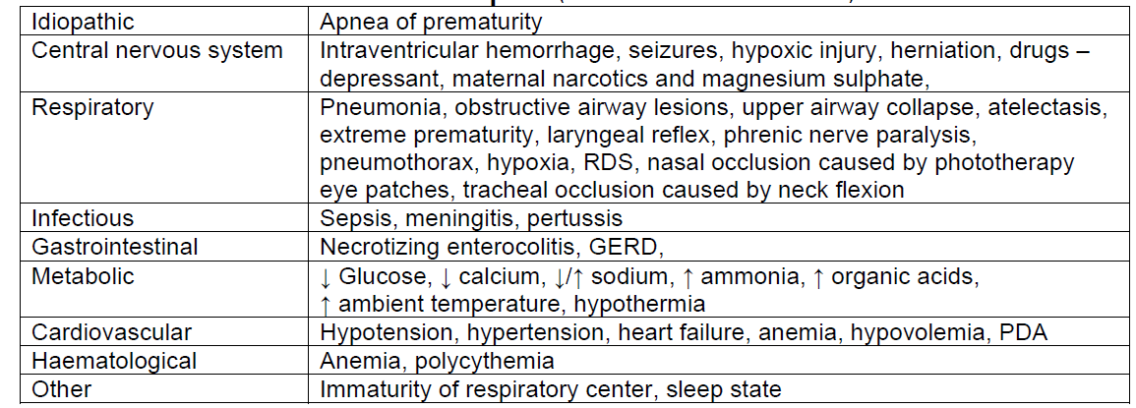
Potential Causes of Neonatal Apnea

Slide 57
Conti…
Idiopathic apnea of prematurity occurs in the absence of identifiable predisposing diseases.
The incidence of idiopathic apnea of prematurity varies inversely with gestational age.
The onset of idiopathic apnea can be during the 1st 1-2 wk after birth but is often delayed if there is RDS or other causes of respiratory distress.
Although apnea of prematurity is the most common cause of apnea in preterm infants, it is a diagnosis of exclusion.

Slide 58
Classification
Classification of apnea is based on whether absent airflow is accompanied by continued inspiratory efforts and upper airway obstruction.
Most spells in preterm infants are mixed.
There are 3 types.
Central apnea
  Occurs when inspiratory efforts are absent.
  It is caused by decreased CNS stimuli to respiratory muscles.
  Both airflow and chest wall motion are absent (no airflow, no respiratory efforts).

Slide 59
Conti…
2. Obstructive apnea
  Occurs when inspiratory efforts persist in the presence of airway obstruction, usually at the pharyngeal level.
  It is characterized by absence of airflow but persistent chest wall motion
  (no airflow, despite respiratory efforts).
3. Mixed apnea
  Occurs (50-75% of cases)
  When airway obstruction with inspiratory efforts precedes or follows central apnea.
Short episodes of apnea are usually central, where as prolonged ones are often mixed.

Slide 60
Monitoring
All babies < 34 weeks’ of gestational age should be monitored continuously for at least the first week of life or until there is an absence of apnoeic episodes for at least 7 days.
Babies >34 weeks’ gestational age should be monitored if they are sick.
Pulse oximeter is an effective way of monitoring apnoea.
  Though it does not detect chest wall movement, it detects the most important clinical consequences of apnoea, i.e.,, hypoxia and bradycardia.
  When a monitor alarm sounds, one should remember to respond to the infant, not to the monitor, checking for bradycardia, cyanosis, and airway obstruction.

Slide 61
Management of apnoea
Immediate measures:
Most apnoeic spells in preterm infants respond to tactile stimulation.
If the infant fails to respond with stimulation, then the infant should be ventilated with a bag and mask.

Slide 62
GENERAL MEASURES
General measures are usually preventive in nature and are applied to all infants less than 35 weeks gestation who are at risk for apnea.
These interventions are directed towards eliminating factors that increase the risk of apnea or reduce the prevalence of associated hypoxia.

Slide 63
Conti…
Environmental and temperature control
Consider underlying causes of new onset of apnea or increased severity
  Such as neonatal sepsis.
  If an underlying factor has been identified, correct it/treat it.
Head and neck position
  Positions of extreme flexion or extension of the neck should be avoided to reduce the likelihood of airway obstruction.
Maintain nasal patency
  Nasal patency is preserved by avoiding vigorous nasal suctioning or prolonged use of NG tubes.
  Care should be taken to avoid reflexes that may trigger apnoea.
Oxygen supplementation to maintain oxygen saturation (SpO₂) at 90 to 95 percent
  To avoid baseline hypoxemia, which predisposes to episodes of severe desaturation.

Slide 64
METHYLXANTHINE THERAPY
Methylxanthines cause stimulation of respiratory neural output, presumably by inhibiting adenosine receptors
Are the primary pharmacologic therapy used to treat apnea of prematurity.
The two methylxanthines used in apnea of prematurity are caffeine and theophylline.
Caffeine is the preferred agent because of its longer half-life, wider margin of safety, and lower frequency of adverse effects

Slide 65
4. Necrotizing Enterocolitis (NEC)
Definition.
NEC is an acute inflammatory injury of the intestine.
The colon appears to be the most commonly affected site.
Characterized by various degrees of mucosal or transmural necrosis of the intestine.
It is associated with inflammation, invasion of enteric gas-forming organisms, and dissection of gas into the muscularis and portal venous system.

Slide 66
Conti…
The triad of intestinal ischemia (injury), enteral nutrition (metabolic substrate), and bacterial translocation has classically been linked to NEC.
NEC is an acute inflammatory disease in the newborn’s intestine characterized by hemorrhagic necrosis, which may lead to perforation and destruction of the gut.

Slide 67
Epidemiology
NEC is the most common surgical emergency in the neonatal period, affecting 0.5% of all live births and 3–5% of low-birth-weight live births.
Although primarily a disease of the preterm infant, 6–13% are in full-term infants.
NEC incidence in developed countries is 7-11% in infants < 1.5 kg.
> 85% of cases of NEC occur among preterm infants (< 32 ks’ gestation).
There is a male preponderance of 2:1.

Slide 68
Etiology
Whilst the precise mechanism of NEC remains unclear, a number of predisposing risk factors have been identified:-
  Low birth weight
  Prematurity
  Enteral feeds
  Sepsis.

Slide 69
Risk factors
Prematurity, especially < 32 weeks, or VLBW
IUGR
Sepsis
Hypoxia
Antenatally detected umbilical artery blood flow abnormalities- (Absent/reversed end– diastolic flow)
Altered intestinal microbe (dysbiosis)/ prolonged antibiotic use
Formula feeding
Lack of antenatal corticosteroid (GA of 24- 34 weeks)
Use of H2 blockers

Slide 70
Conti…
Prematurity
Approximately 90% of NEC cases are found in premature infants, with mean gestational age of 30–32 weeks.
The increased incidence of NEC in this group may be due to:-
  Greater susceptibility of the premature gut to the stresses of hypoxia, ischemia and the mucosal damage of hyperosmolar feeds in this group.

Slide 71
EPIDEMIOLOGY AND PATHOGENESIS
The timing of the onset of NEC varies inversely with gestational age.
In the severely premature neonate, onset often occurs in the fourth week after birth.
In neonates born closer to term, onset typically occurs in the first week of birth.
The lower the birthweight of a neonate, the greater is the risk of developing NEC.
Only approximately 10% of cases occur in full-term newborns.

Slide 72
Pathophysiology
The precise pathophysiology of NEC remains unclear, but it is considered to be multifactorial in origin.
  The culmination of microbial colonization and inflammatory insult with mucosal injury to an intestine that is compromised by hypoxic ischemia and/or immaturity.
Hypoxia and circulatory ischemia result in preferential distribution of the limited blood supply to vital organs such as the heart, brain and kidney, at the expense of compromising blood flow away from non-vital regions including the splanchnic circulation of the intestinal tract (the Herring–Breur reflex).

Slide 73
Conti…
Intestinal ischemia and bacterial colonization stimulate proinflammatory mediators (including interferonγ,tumor necrosis factor (TNF)-α23 and platelet activating factor (PAF), which through multiple cascades may lead to variable degrees of coagulative and ischemic necrosis of the bowel.
Furthermore free radicals released from inflammatory cascades following ischemia and reperfusion contribute to the tissue necrosis by causing lipid peroxidative damage to cellular membranes.
Diffusion of free radicals and the effect of gasforming organisms within the gut wall result in the pathognomonic pneumatosis intestinalis that is seen on radiographs in 90% of cases.
Transmural necrosis with bacterial translocation across the gut wall may result in perforation with peritonitis, bacteremia or septicemia

Slide 74
Conti…
Up to 35% of patients with NEC have positive cultures, with the most common implicated pathogens being Klebsiella, Escherichia coli, Clostridium difficile and Streptococcus faecalis.
The increased propensity of premature infants to develop NEC injury is attributed to a number of additional factors.
These include a deficient intestinal microbial host defense, poor development of the mucosal barrier,an immature mucosa at greater susceptibility to hyperosmolar feeds and an accentuated pro-inflammatory response.
If the intestinal injury is short-lived, the pathological course may be followed by healing with fibrosis, with or without a resulting stricture in the affected bowel.
The disease most commonly involves the terminal ileum and ascending colon, but it may affect variable segments of the small and large intestine, being isolated (30%), multifocal (55%) or pan-intestinal (15%).

Slide 75
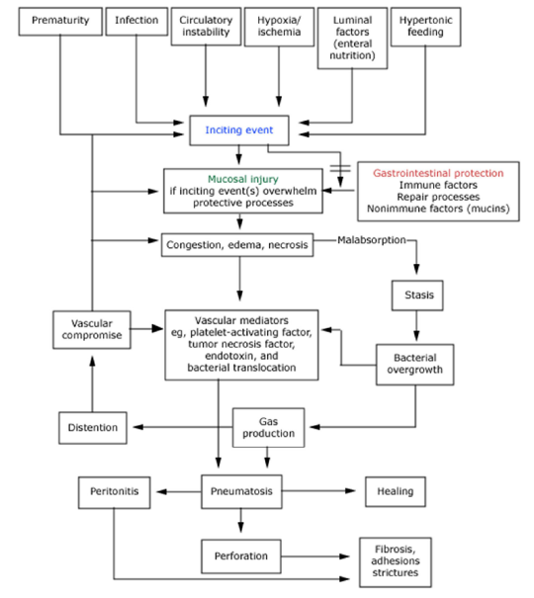

Slide 76
Clinical signs and symptoms
The clinical course of NEC is variable.
The severity of the disease may be categorized clinically using the original Bell’s staging system for NEC, a classification later modified by Walsh and Kliegman.

Slide 77
Conti…
Stage I
Suspected NEC.
At the early stage, symptoms and signs are usually non-specific.
e.g. irritability, fever, apneas and bradycardias, and poor toleration of feeds.
Many of these children are more likely to be suffering from feeding intolerance commonly associated with prematurity or low birth weight.

Slide 78
Conti…
Stage II
Established NEC.
These babies will have established clinical and radiographic signs of NEC with moderate–profound systemic illness, including metabolic acidosis and thrombocytopenia.
Vomiting/aspirates are usually bilious or bloodstained whilst stools are likely to be blood-stained.
Abdominal distension, abdominal wall erythema and edema are usual.
There may or may not be evidence of perforation clinically and/or radiologically.
A clinically palpable intra-abdominal mass (reported in 11%) may indicate the presence of persistently dilated bowel loops or, if the disease is localized, an intraperitoneal abscess.

Slide 79
Conti…
Stage III
Advanced NEC with systemic instability.
As well as features of stage II disease, these babies have cardiovascular instability (hypotension), severe metabolic acidosis and coagulative derangements.
There will usually be abdominal and radiological evidence of perforation, peritonitis and ascites with generalized sepsis.

Slide 80
Complications
Metabolic disorders including metabolic acidosis and disseminated intravascular coagulation.
Perforation with peritonitis and septicemia
Localized intraperitoneal abscess formation
Healing by fibrosis with stricture formation
(20% in term infants and 31% in preterm infants)

Slide 81
Conti…
4. Massive gut involvement that requires resection may result in short-bowel syndrome, with resultant failure to thrive or, worse still, pan-intestinal involvement that is incompatible with life.
5. Recurrence of the disease (9–14%)
6. Infants with stage II or III disease are commonly at risk of developing psychomotor retardation, although this may be more attributed to the high incidence of prematurity than a direct effect of NEC.

Slide 82
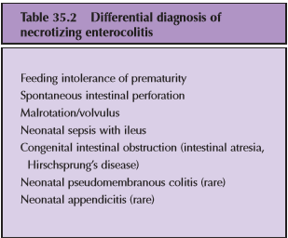

Slide 83
Diagnosis
Investigations for diagnosis of NEC include the following.
Abdominal X-ray may demonstrate:-
  Dilated bowel loops
  Edematous bowel wall
  Ascites
  Intramural gas (pneumatosis intestinalis)
  Portal vein gas and free air in the peritoneal cavity (pneumoperitoneum).

Slide 84
Conti…
Signs of a pneumoperitoneum include
  ‘Football sign’ (central collection of free air outlining the falciform ligament and umbilical arteries)
  Localized gas in the right upper quadrant (the ‘right upper quadrant gas sign’), or
  Gas on both sides of the bowel wall (‘Rigler’s sign’).
The presence of a single/multiple loops of bowel retaining the same shape or position for 24–36h (‘fixed-loop sign’) may suggest full-thickness bowel necrosis.

Slide 85
Conti…
CBC
  In metabolic acidosis, the hemoglobin level may fall, owing to hemorrhage and sepsis, whilst leukocyte and platelet counts may be depressed, particularly in association with DIC.
Bacteriological screening should include blood culture and collection of swabs from the nose, throat, umbilicus and rectum.
Serum electrolyte
Triads of NEC (Laboratory)…..Hyponatremia, Thrombocytopenia and Metabolic acidosis

Slide 86
Treatment
Medical
The initial management of NEC consists of stabilization of the infant and resting of the intestinal tract by means of discontinuation of enteral feeds for 10 days, total parenteral nutrition, decompression of the stomach by a nasogastric tube, fluid resuscitation, intravenous antibiotics for 7–14 days and correction of any metabolic derangement.
Surgery
However, up to 50% of neonates with NEC develop advanced disease that requires surgery.

Slide 87
Prognosis
The outcome from NEC is highly variable
  With the postoperative complication and mortality rates ranging between 10 and 70%.
These depend on:
  Stage of the disease
  Extent of disease involvement, with the lowest survival in pan-intestinal disease
  Birth weight
  Gestational age with 77% survival in term infants compared to 66% in preterm infants
  Presence of associated medical co-morbidities
  Modality of operative treatment.
This affects the postoperative complication rate for multifocal NEC
  (85% survival after resection and primary anastomosis
  Compared to 50% with enterostomy alone) but not isolated NEC.

Slide 88
Follow up of Preterm baby
Follow weight gain at least 15-20gm/kg/day
Follow for head circumference 1cm/wk
Anthropometic measurement using corrected age
Vision assessment
Hearing assessment
Brain ultrasound
Development assessment
Assess for anemia, rickets and bleeding tendencies

Slide 89
REFERENCES
NELSON TEXTBOOK OF PEDIATRICS 21 EDIT
UPTO DATE 2022
NICU NATIONAL GUIDELINE 2021
FANAROFF AND MARTIN’S NEONATAL-PERINATAL MEDICINE 11th EDIT.
Cloherty-and-Starks-Manual-of-Neonatal-Care-2021

